Slide 1
Food and Beverage Management fifth edition
Chapter 6
Beverage Provision

Slide 2
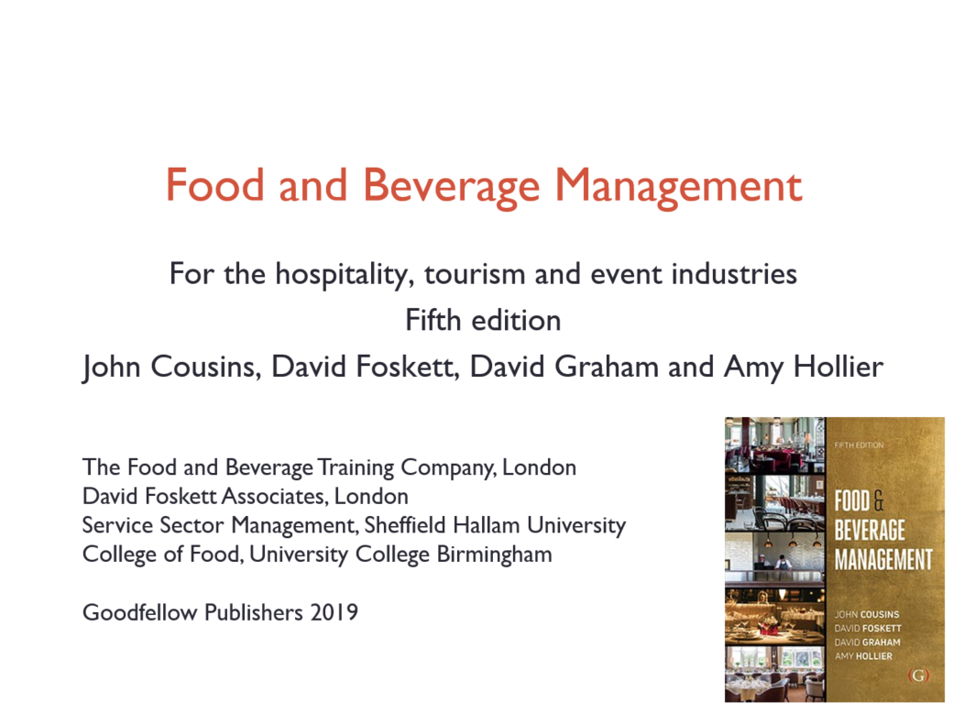

Slide 3
Chapter 6 covers:
Safe, sensible drinking
Types of wine and drink lists
Developing wine and drink lists
Purchasing
Further consideration on wine provision
Storage
Beverage control

Slide 4
Safe, sensible drinking
Small amount of alcohol does no harm and can even be beneficial
The more you drink the greater the health risks
Increasing concern about higher levels of alcohol consumption
Various initiatives are being tried
Those who sell and serve alcoholic beverages are encouraged to become more responsible
Important members of staff are aware of restrictions on sale of alcohol

Slide 5
Effects of alcohol
Depresses the brain and nerve function
Affects a person’s judgement, self-control and skills
The four general stages of becoming drunk:
  Stage 1: Happy
  Stage 2: Excited
  Stage 3: Confused
  Stage 4: Lethargic

Slide 6
Alcoholic strength
Two main scales:
  Organisation Internationale Métrologie Légale (OIML) Scale (European): range 0% to 100% alcohol by volume
  American Scale (USA): range 0° to 200°
Liquid measured as 40% alcohol by volume (ABV) has 40 per cent of the contents as pure alcohol
Liquid measured as 80° on USA scale is the same as 40% ABV

Slide 7
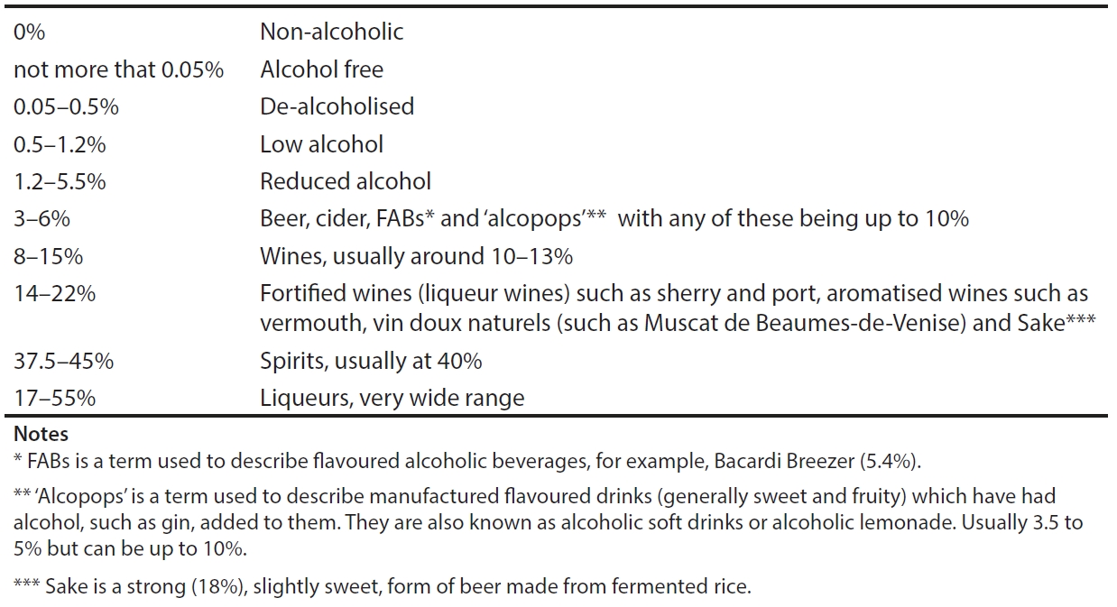
Approximate alcoholic strength:

Slide 8
Sensible Limits
UK has set the limits at:
  14 units spread throughout the week for men and women (excluding pregnant women)
Drinking in excess of these limits is likely to be damaging to health

Slide 9
Unit of alcohol
One units of alcohol is equal to 10 millilitres (liquid) or 8 grams (weight) of alcohol
Roughly equivalent to:
  ½ pint of ordinary beer or lager
  one glass of wine (125 ml)
  one glass of sherry (50 ml)
  one measure of vermouth or other apéritif (50 ml)
  one measure of spirits (25 ml)

Slide 10
Calculating alcohol intake for wine
Specific percentage of alcohol times the amount in litres, equals the units of alcohol per bottle
For example:
  Wine at 12% alcohol by volume x 0.75 litre bottle = 9 units per 75 cl bottle
  This 75 cl bottle of wine will give 6 x 125 ml individual glasses of wine and each glass will contain 1.5 units of alcohol (9 units in the whole bottle divided by the 6 glasses)

Slide 11
Example for other drinks
Lager at 5% alcohol x 0.50 litre measure = 2.5 units per half litre measure
Spirit at 40% alcohol x 0.025 litre (25ml) measure = 1 unit per 25 ml measure
Sherry at 18% alcohol x 0.05 litre (50 ml) measure = 0.9 unit per 50 ml measure

Slide 12
Types of wine and drinks lists
Bar and cocktail
Apéritif
Restaurant
After meal drinks (digestifs)
Banqueting, function and events
Room service
Lounge service

Slide 13
Hot beverages
Tea
Coffee
Chocolate

Slide 14
Teas
Can include:
  General basic teas
  More specialise teas such as: Darjeeling, Earl Grey, Jasmine
  Iced teas
  Flavoured teas (tisanes)

Slide 15
Espresso based coffee styles
Espresso
Espresso doppio
Café crème
Espresso ristretto
Americano
Espresso macchiato
Espresso con panna
Cappuccino
Caffè (or café) latté
Flat white
Latte macchiato
Caffè mocha (or mochaccino)

Slide 16
Non-alcoholic bar beverages
Five main groups:
  Aerated waters: e.g. bitter lemon, cola
  Natural spring/mineral waters
  Squashes
  Juices
  Syrups such as:
      Cassis (blackcurrant)
      Grenadine (pomegranate)

Slide 17
Consumer demand for bottled waters
Reducing because of:
  Environmental and sustainability concerns leading to higher customer demand for tap water
  Emergence of commercial water filtration systems

Slide 18
Developing wine and drink lists
Must be in keeping with style of operation
Easy to handle and use
Durable
Flexible (how often needing to be updated)
Well designed and legible
Meet legal requirements
Include bin number for wines

Slide 19
Professionalism in beverage provision
Increasing as a result of:
  Qualifications
  Competitions
  Trade and professional bodies
  Recognised job titles

Slide 20
Contents of wine and drink lists
Usually listed in the order consumed:
  Apéritifs
  Cocktails
  Spirits and associated mixers
  Wines – still, sparkling and fortified
  Beers, cider, perrys
  Non-alcoholic drinks (cold)
  Digestifs
  Hot beverages

Slide 21
Listing of wines
By place of origin (geographical)
By type - still (white rosé, red,) fortified, sparkling
By grape

Slide 22
General information given – wines:
Bin number
Name of wine
Country and area of origin
Quality indication (e.g. AOC, Qmp etc.)
Shipper
Château/estate bottled
Varietal (grape type(s))
Vintage
Alcoholic strength
½ bottle, bottle, magnum
Price
Supplier
Descriptive notes as appropriate

Slide 23
Information on other drinks:
Type of drink
Brand name if appropriate
Style (sweet, dry, etc.)
Description, for example for cocktails
Alcoholic strength in percentage by volume as appropriate

Slide 24
Pricing
Cost plus
Rate of return
Market orientated
Fixed mark-up
BYOB and corkage charges

Slide 25
Maintaining stock levels
Stock levels may be determined by using past sales data
A useful formula is: M = W (T+L) + S
Where:
  M is the maximum stock
  W the average usage rate
  T the review period
  L the lead time and
  S the safety stock (buffer or minimum stock level)

Slide 26
Example calculation
W = 24 bottles per week
T = 4 weeks
L = 1 week
S = 1 week’s usage, e.g. 24 bottles
Therefore maximum stock is:
  M = W (T+L) + S = 24 (4+1) +24 = 144 bottles
Minimum stock (buffer or safety stock) is:
  L × W = 1 × 24 = 24 bottles
ROL (reorder level) is:
  (W × L) +S = (24 × 1) + 24 = 48 bottles.

Slide 27
Purchasing
Using one main or a variety of suppliers
Also need to take into account:
  Cost of purchasing
  Determining stock levels

Slide 28
Purchasing wines
Fine wine merchant/distributor
(Branded) wine merchant/distributor
Brewery wine division
Direct from producer
En primeur
Wine retailers
Wine clubs
Internet
Wine fair
Auction rooms
Brokers
Tastings

Slide 29
Maintain quality of drink stock
Regular tasting, or evaluation, of wine and other drinks is carried out to:
  Develop learning from experience
  Help in the assessment of the quality of a wine in terms of value
  Monitor the progress of a wine that is being stored
  Assist in the description of a wine when explaining its qualities to customers
  Provide a record of wines tasted

Slide 30
Professional approach to tasting
Three key stages:
  Recording the details of each individual wine or drink
  Looking at, smelling and tasting the wine or drink
  Recording the findings

Slide 31
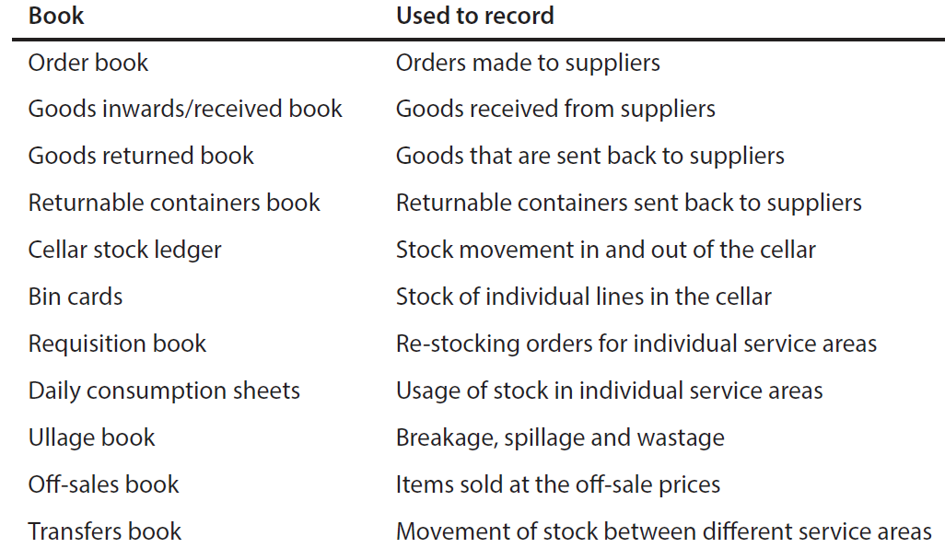
Beverage control ‘books’

Slide 32
Analysing sales
Gross profit margin
Sales mix data
Logging requests for wines and drinks not on the list
Monitoring against the competition
Managing stock and changes to the lists based on popularity and profitability of items

Slide 33
Determining cost of sales
Traditional approach:
  The value of opening stock
  Plus value purchases
  Less value of issues
  Equals the cost of sales
This is a very laborious process

Slide 34
Determining cost of sales
Alternative method:
  Par stock levels set for individual outlets (by number of items)
  Only important to control is the cost of actual sales
  Therefore, only the cost of goods issued to the outlets needs to be calculated
  Stock levels are monitored by quantity

